Slide 1
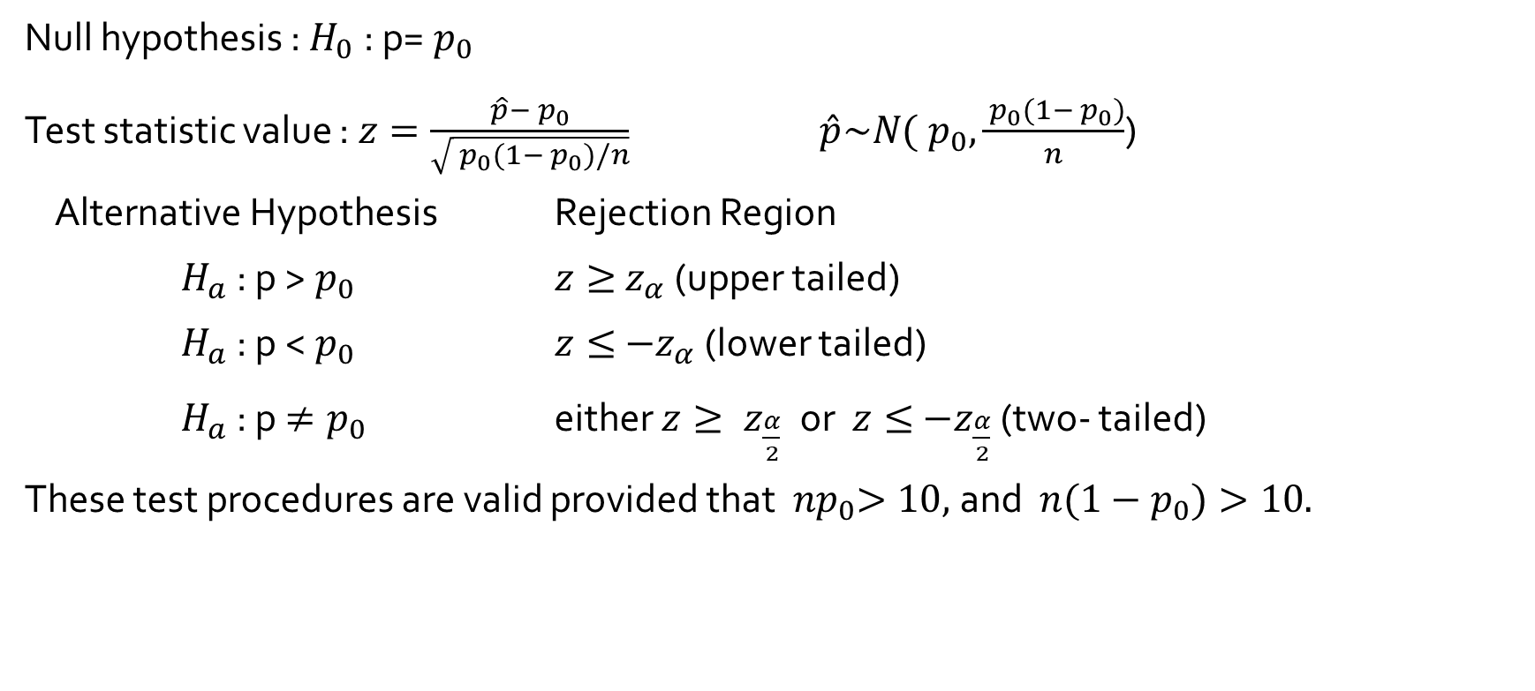
Test on a proportion : Large-Sample Tests
Null hypothesis : $H_{0}$ : p=${ p}_{0}$
Test statistic value : $z=\frac{\hat{p}−{ p}_{0}}{\sqrt{{ p}_{0}(1−{ p}_{0})/n}}$ $\hat{p}\sim N({ p}_{0}, \frac{{ p}_{0}(1−{ p}_{0})}{n}$)
Alternative Hypothesis Rejection Region
$H_{a}$ : p >${ p}_{0}$ $z≥{ z}_{α}$ (upper tailed)
$H_{a}$ : p <${ p}_{0}$ $z≤{ −z}_{α}$ (lower tailed)
$H_{a}$ : p${ ≠p}_{0}$ either $z≥{ z}_{\frac{α}{2}} \text{or}$ $z≤{ −z}_{\frac{α}{2}}$ (two- tailed)
These test procedures are valid provided that ${ np}_{0}>10,$and ${ n(1−p}_{0})>10.$

Slide 2
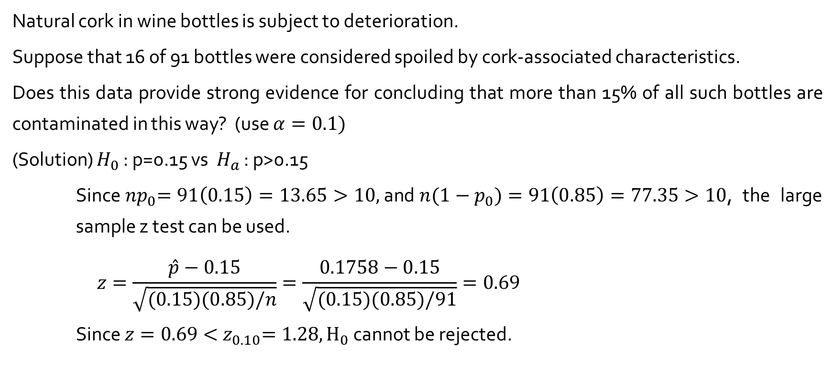
Example 8.11
Natural cork in wine bottles is subject to deterioration.
Suppose that 16 of 91 bottles were considered spoiled by cork-associated characteristics.
Does this data provide strong evidence for concluding that more than 15% of all such bottles are contaminated in this way? (use $α=0.1)$
(Solution) $H_{0}$ : p=0.15 vs $H_{a}$ : p>0.15
Since${ np}_{0}=91\left(0.15\right)=13.65>10,$and${ n(1−p}_{0})=91\left(0.85\right)=77.35>10$, the large sample z test can be used.
$$z=\frac{\hat{p}−0.15}{\sqrt{(0.15)(0.85)/n}}=\frac{0.1758−0.15}{\sqrt{(0.15)(0.85)/91}}=0.69$$
Since $z=0.69<{ z}_{0.10}=1.28, H_{0}$ cannot be rejected.

Slide 3

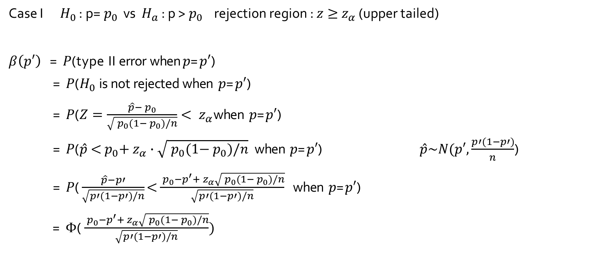
$β$ and sample size computation
Case I $H_{0}$ : p=${ p}_{0}$ vs $H_{a}$ : p >${ p}_{0}$ rejection region : $z≥{ z}_{α}$ (upper tailed)
$β\left(p′\right) \text{=} P\text{(}\text{t}\text{y}\text{p}\text{e} \text{I}\text{I} \text{err}\text{o}\text{r} \text{when} p\text{=}p′\text{)}$
$\text{ = }P\text{(}H_{0} \text{i}\text{s} \text{no}\text{t} \text{rejecte}\text{d} \text{when} p\text{=}p′\text{)}$
$\text{ = }P\text{(}Z=\frac{\hat{p}−{ p}_{0}}{\sqrt{{ p}_{0}(1−{ p}_{0})/n}}<{ z}_{α}\text{when} p\text{=}p′\text{)}$
$\text{ = }P\text{(}\hat{p}\text{ <}{ p}_{0}\text{+}{ z}_{α}∙\sqrt{{ p}_{0}(1−{ p}_{0})/n} \text{when} p\text{=}p′\text{)}$ $\hat{p}\sim N(p′, \frac{p′(1−p′)}{n}$)
$\text{= }P\text{(}\frac{\hat{p}−p′}{\sqrt{p′(1−p′)/n}}\text{<}\frac{{ p}_{0}−p^{′}+{ z}_{α}\sqrt{{ p}_{0}(1−{ p}_{0})/n}}{\sqrt{p′(1−p′)/n}} \text{when} p\text{=}p′\text{)}$
$\text{ = }Φ\text{(}\frac{{ p}_{0}−p^{′}+{ z}_{α}\sqrt{{ p}_{0}(1−{ p}_{0})/n}}{\sqrt{p′(1−p′)/n}})$

Slide 4
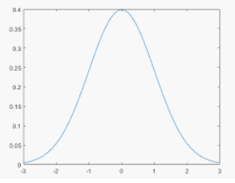
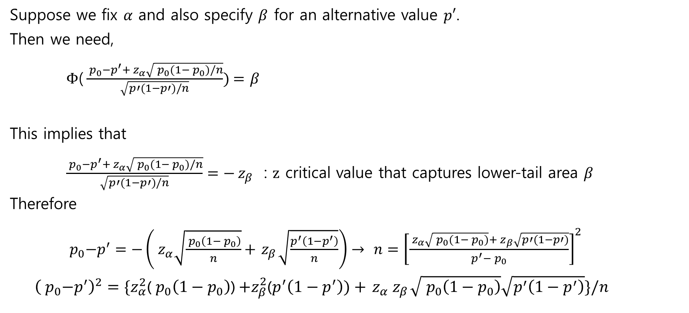

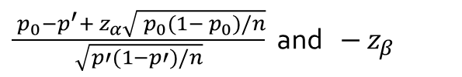
$β$ and sample size computation
Suppose we fix $α$ and also specify $β$ for an alternative value $p′$.
Then we need,
$Φ\text{(}\frac{{ p}_{0}−p^{′}+{ z}_{α}\sqrt{{ p}_{0}(1−{ p}_{0})/n}}{\sqrt{p′(1−p′)/n}})=$ $β$
This implies that
$\frac{{ p}_{0}−p^{′}+{ z}_{α}\sqrt{{ p}_{0}(1−{ p}_{0})/n}}{\sqrt{p′(1−p′)/n}}=−{ z}_{β }$ : $z$ critical value that captures lower-tail area $β$
Therefore
${ p}_{0}−p^{′}=−\left({ z}_{α}\sqrt{\frac{{ p}_{0}\left(1−{ p}_{0}\right)}{n}}+{ z}_{β}\sqrt{\frac{p^{′}\left(1−p^{′}\right)}{n}}\right)→$ $n={\left[\frac{{ z}_{α}\sqrt{{ p}_{0}(1−{ p}_{0})}+{ z}_{β}\sqrt{p′(1−p′)}}{p^{′}−{ p}_{0}}\right]}^{2}$
${\left({ p}_{0}−p^{′}\right)}^{2}=\{z_{α}^{2}$(${ p}_{0}\left(1−{ p}_{0}\right)$) $+z_{β}^{2}$($p^{′}\left(1−p^{′}\right))+{ z}_{α}{ z}_{β}\sqrt{{ p}_{0}\left(1−{ p}_{0}\right)}\sqrt{p^{′}\left(1−p^{′}\right)}\}/n$
$$β$$
$\frac{{ p}_{0}−p^{′}+{ z}_{α}\sqrt{{ p}_{0}(1−{ p}_{0})/n}}{\sqrt{p′(1−p′)/n}}$ and $−{ z}_{β }$

Slide 5
β(p’) Summary

